Slide 1


prediction of COVID-19diagnosis based on symptoms

Slide 2

GROUP Members
MD. TANBIN HOSSAIN HIMEL
  2018-1-60-151
NAZMUS SAKIB
  2018-1-60-104
KAMRUZZAMAN LEEON
  2018-1-60-252
FAHIM FAIZ ABIR
  2018-1-60-032

Slide 3
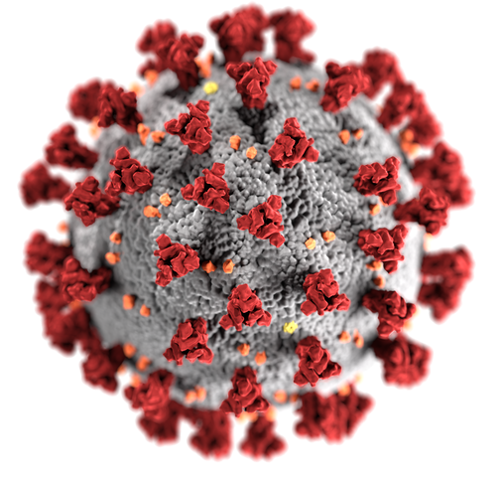
OUR GOAL
Predict COVID-19 from symptom

Slide 4
RESEARCH PAPER 01
Machine learning-based prediction of COVID-19 diagnosis based on symptoms^{[1]}
-Yazeed Zoabi, Shira Deri-Rozov and Noam Shomron

Slide 5

DATASET FEATURES
Basic information:
  Sex (male/female).
  Age ≥60 years (true/false)
Symptoms:
  Cough (true/false).
  Fever (true/false).
  Sore throat (true/false).
  Shortness of breath (true/false).
  Headache (true/false).
Other information:
  Known contact with an individual confirmed to have COVID-19 (true/false).

Slide 6


OUTCOME
Predict if the patient has COVID-19.

Slide 7
Development of the model
Predicted using a gradient-boosting machine model built with decision-tree base-learners.
Missing values were inherently handled by the gradient-boosting predictor.
Gradient-boosting predictor trained with the LightGBM Python package.
Principal features are identified using SHAP values.
Contribution of each feature calculated by averaging SHAP values.

Slide 8
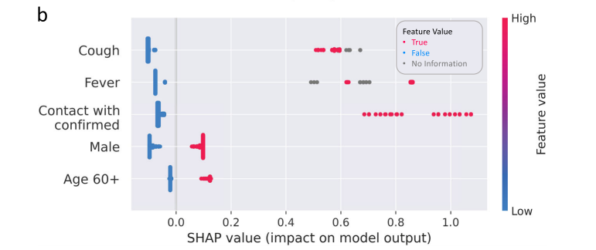
Development of the model
IMPORTANT FEATURES (SHAP VALUE):
  COUGH
  FEVER
  Known contact with confirmed
  MALE
  AGE 60+

Slide 9
Evaluation of the model
Test sets are scored using the auROC.
Calculate matrices for all the thresholds from all the ROC curves, including sensitivity, specificity, PPV and negative predictive value, false-positive rate, false-negative rate, false discovery.
ACCURACY: 0.90.
Confidence intervals (CI) for the various performance measures were derived through resampling, using the bootstrap percentile method with 1000 repetitions.

Slide 10
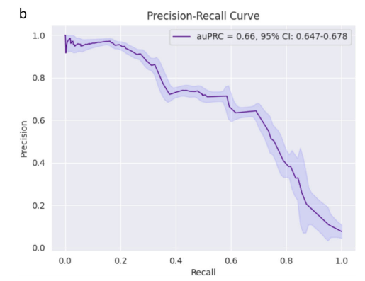
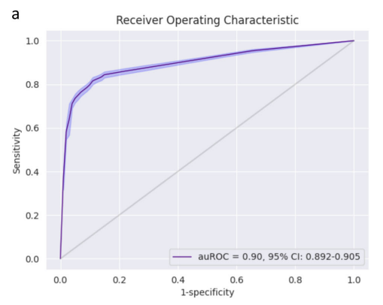
Evaluation of the model

Slide 11
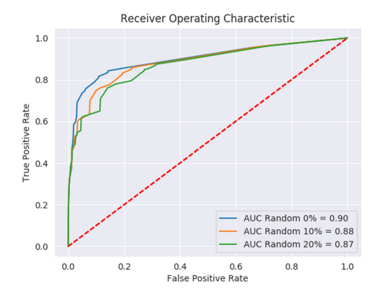
Evaluation of the model

Slide 12
PROS AND CONS
PROS:
  WORK FAST
  MISSING DATA IS GENERATED GRADIANT BOOSTING PREDICTOR.
CONS:
  CAN NOT FIND THE BEST ACCURACY AMONG ALL TRADITIONAL MODELS.
  HYPER PARAMETER TUNING IS NOT DISCUSSED

Slide 13
RESEARCH PAPER 02
Machine learning based approaches for detecting COVID-19 using clinical text data^{[2]}
-Akib Mohi Ud Din Khanday, Syed Tanzeel Rabani, Qamar Rayees Khan,
Nusrat Rouf, Masarat Mohi Ud Din

Slide 14
DATASET FEATURES
FEATURES ARE-
  patient id, offset, sex, age, finding, survival, intubated, went_icu, needed_supplemen-tal_O2, extubated, temperature, O2_saturation, leuko-cyte_count, neutrophil count, lymphocyte count, view, modality, date, location, folder, filename, DOI, URL, License, Clinical notes and other notes.
TOTAL FEATURE: 24

Slide 15

OUTCOME
Predict if the patient has-
  COVID
  ARDS
  SARS
  Both (COVID, ARDS)

Slide 16
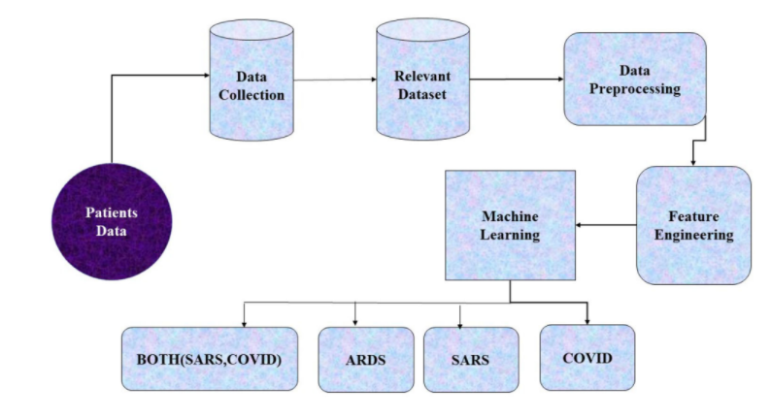
Methodology

Slide 17
Development of the model
Traditional machine learning algorithms are used-
  Logistic regression
  Random forest classifier
  Support vector machine (SVM)
  AdaBoost
  Bagging
  Stochastic gradient boosting
  Decision trees
  Multinomial Nave Bayes
Sciket learn tool is used for performing machine learning classification with the help of-
  NLTK
  STOP-WORDS etc.
For improving the accuracy of all the machine learning algorithms pipeline is being used.

Slide 18
Development of the model
The data is being split into 70:30.
The tenfold cross-validation strategy was conducted for all algorithms
Repeated five times independently to avoid the sampling bias introduced by randomly partitioning the dataset in the cross-validation.

Slide 19
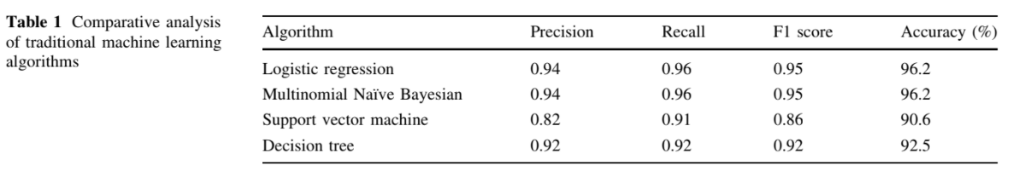
Evaluation of the model
Logistic regression and Multinomial Naive Bayes Algorithm shows better result than all other algorithms by having precision 94%, recall 96%, F1 score 95% and accuracy 96.2%.
random forest, gradient boosting also showed good results by having accuracy 94.3% respectively.

Slide 20
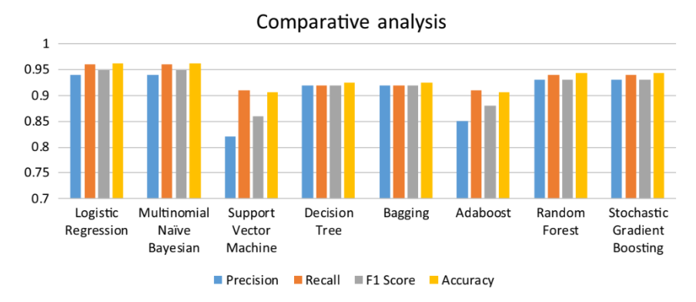
Evaluation of the model

Slide 21
PROS AND CONS
PROS:
  WORK WITH MULTIPLE TRADITIONAL MODELS AT THE SAME TIME ON THE SAME DATASET.
  CAN FIND THE BEST ACCURACY AMONG ALL TRADITIONAL MODELS.
  Repeated five times independently to avoid the sampling bias.
CONS:
  TIME CONSUMING
  HYPER PARAMETER TUNING IS NOT DISCUSSED
  MISSING DATA IS NOT HANDLED SMARTLY

Slide 22
OUR Methodology
TANBIN, LEEON, SAKIB, ABIR
TANBIN, LEEON, SAKIB, ABIR
TANBIN, LEEON, SAKIB, ABIR
PATIENT DATA
DATA
COLLECTION
RELEVANT
DATASET
DATA
Preprocessing
TANBIN
Neural Network
TANBIN, LEEON, SAKIB, ABIR
LEEON
Processing
Naïve Bayes
Feature
Engineering
SAKIB
Logistic Regression
TANBIN, LEEON, SAKIB, ABIR
ABIR
COVID-19
POSITIVE
COVID-19
NEGATIVE
Decision Tree
TANBIN
Random Forest

Slide 23
REFERENCES
[1] Y. Zoabi, S. Deri-Rozov and N. Shomron, "Machine learning-based prediction of COVID-19 diagnosis based on symptoms", npj Digital Medicine, vol. 4, no. 1, 2021. Available: 10.1038/s41746-020-00372-6 [Accessed 24 April 2021].
[2] A. Khanday, S. Rabani, Q. Khan, N. Rouf and M. Mohi Ud Din, "Machine learning based approaches for detecting COVID-19 using clinical text data", International Journal of Information Technology, vol. 12, no. 3, pp. 731-739, 2020. Available: 10.1007/s41870-020-00495-9 [Accessed 24 April 2021].

Slide 24
THE END

